Slide 1
Epithelium
•Layer of cell
•Cover the body structure

Slide 2
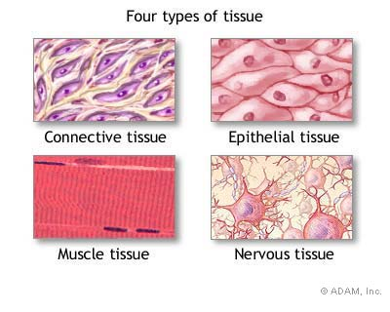
Basic tissue types
There are 5 types of human tissue
  1. Epithelial
  2. Connective
  3.Blood
  4. Muscle
  5. Nervous

Slide 3
Epithelial tissue
Epithelium is defined as a collection of closely packed cells with very small amount of intercellular substance that cover on line body surfaces, cavities and tubes
All epithelia are supported by a variable amount of loose connective tissue containing many blood vessels
Epithelium itself is avascular, nourished by diffusion from the blood vessels in underlying loose connective tissue

Slide 4
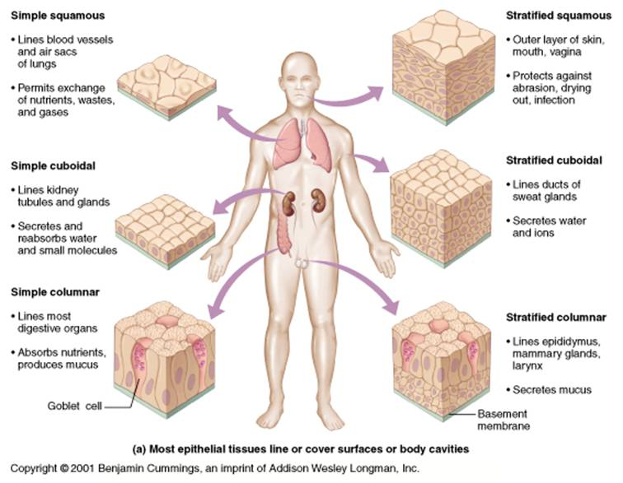

Slide 5
Basement membrane
All type of basement membrane rest on a thin delicate, noncellular layer called basement membrane or basal lamina
It is composed of proteoglycans, glycoprotein's and collagen
There are two main groups of epithelia
Covering or surface epithelia
Glandular epithelia

Slide 6
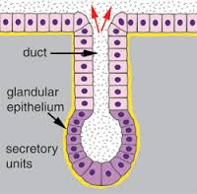

Slide 7
Covering of surface epithelia
These cover body surfaces, cavities and tubes
Depending on the number of cell layer, these are divided into
Simple epithelium
Consists of only a single layer of cells
Stratified epithelia
Consists of two or more layers of cells

Slide 8
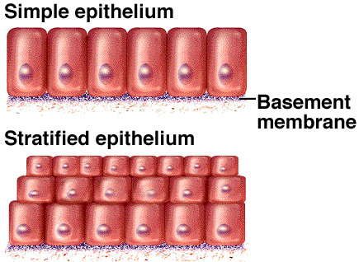

Slide 9
Simple epithelia
Further subdivided depending on the shape of cells
Simple squamous:
Composed of flat, plate like cells
Simple cuboidal:
Composed of cube like cells
Simple columnar:
Composed of column like cells
Pseudo stratified:
Consist of a single layer of cells but gives a false impression of stratification

Slide 10
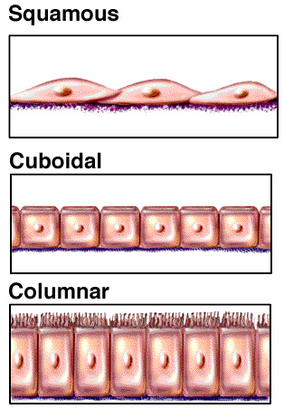

Slide 11
Simple squamous epithelium
Single layer of cells lying on BM
Each cell contains an ovoid or flattened centrally placed nucleus
Examples:
Endothelium: which covers the internal surface of heart, blood vessels and lymphatics
Mesothelium: lines the pericardial, pleural and peritoneal cavities
Alveolar epithelium

Slide 12
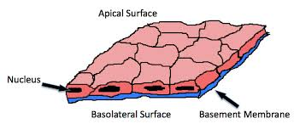

Slide 13
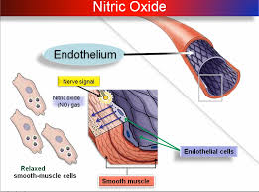

Slide 14
Simple cuboidal epithelium
Single layer of square shaped cells
Each cell contains a spherical centrally placed nucleus
On surface view the cells are hexagonal or polygonal
Examples:
Distal convulated tubules of nephron
Surface epithelium of ovary
Small ducts of many glands

Slide 15
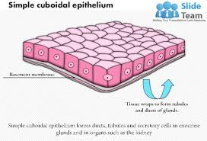

Slide 16
Simple columnar epithelium
Single layer of column shaped cells
Each cell contains an oval nucleus
On surface view the cells are hexagonal
Examples:
Simple columnar nonciliated:
Lines gall bladder, stomach and small intestine
Simple columnar ciliated:
Lines the uterine tubes and uterus

Slide 17
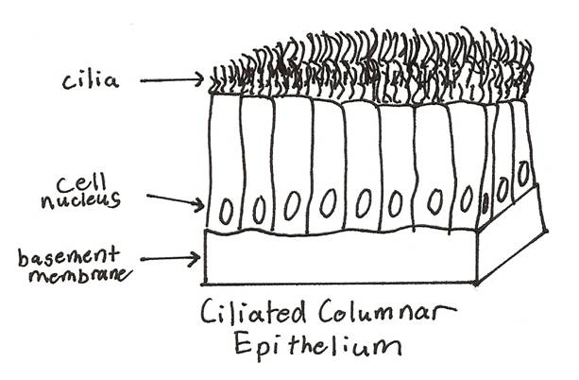

Slide 18
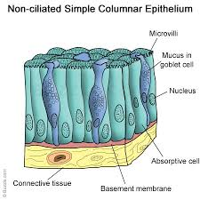

Slide 19
Pseudostratified columnar ciliated epithelium
Single layer of cells that gives false impression of being stratified because the nuclei lie at different levels
All cells rest on basement membrane
Examples:
Conducting parts of respiratory system
Eustachian tubes, nasal cavities, nasopharynx, paranasal sinuses

Slide 20
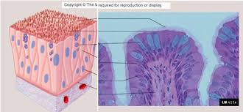

Slide 21
Stratified epithelia

Slide 22
Stratified epithelia
Depending on the shape of the upper most layer, it is further subdivided into:
Stratified squamous
Stratified cuboidal
Stratified columnar
Transitional epithelium

Slide 23
Stratified squamous epithelium
Multiple layers of cells lying on a basement membrane
Basal cells are low columnar which can divide
Few layers of large polygonal cells lie next to basal layer
Superficial cells become gradually flattened and surface cells are squamous
This epithelium is of two types

Slide 24
i:Stratified squamous keratinized epithelium
The surface cells are non- nucleated and contain a protein called keratin
Example:
Epidermis of skin
Epithelial lining of oral cavity

Slide 25
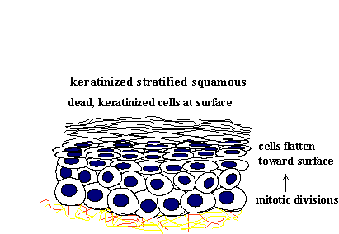

Slide 26
ii:Stratified squamous non- keratinized epithelium
There is no keratin formation
Example:
It lines
Parts of oral cavity
Esophagus, oropharynx
Lower part of anal canal
Vagina

Slide 27
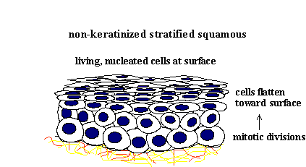

Slide 28
Stratified cuboidal epithelium
Consists of two layers of cuboidal cells
Each cell contains a spherical centrally placed nucleus
Example:
It has very restricted distribution
Ducts of sweat glands

Slide 29
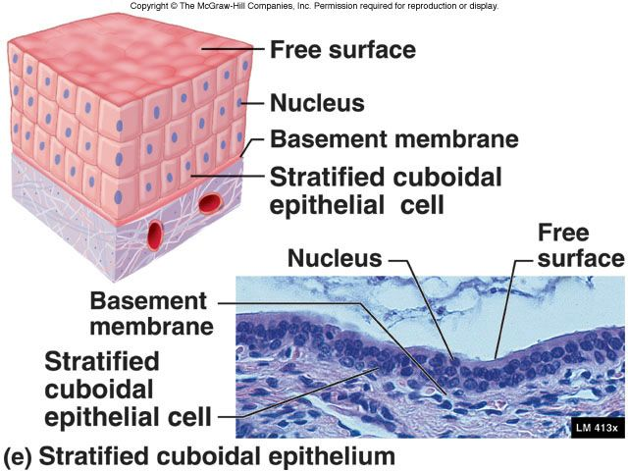

Slide 30
Stratified columnar epithelium
Consists of surface columnar cells which rest on one or more layers of roughly cuboidal cells
Examples
It lines
Parts of ductus deferns and male urethra
Main ducts of salivary glands
Conjuctival epithelium

Slide 31
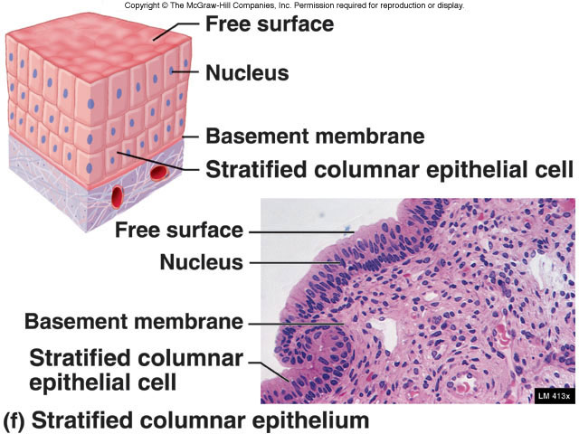

Slide 32
Transitional epithelium
It is a special type of stratified epithelium which varies in its appearance depending on the state of distension of the organ
Examples:
Renal calyces, renal pelvis, ureters, urinary bladder and part of urethra

Slide 33
Modification at the free surface of epithelial cells
Microvilli
Cilia
Flagellum
stereocilia

Slide 34
Microvilli
These are small, slender, finger like projections found on free surface of epithelial cells.
1-2µm in height and 0.1µm in diameter
Examples and functions:
Epithelial cells of small intestine
Epithelial cells of proximal convulated tubule of nephron
They greatly increase the surface area and help in the absorption

Slide 35
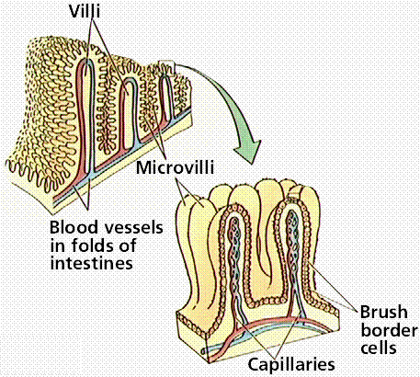

Slide 36
Cilia
These are hair like processes found chiefly on free surface of those epithelial cells which are specialized for transport of fluid or mucus over the epithelial surface.
It measures 5-10µm in length and about 0.2µm in diameter
Example and functions:
Respiratory epithelium
Epithelial lining of uterine tubes and uterus
Cilia are capable of rapid to and fro movement resulting in propulsion of a layer of mucus, fluids particulate matter or ovum over the epithelium

Slide 37
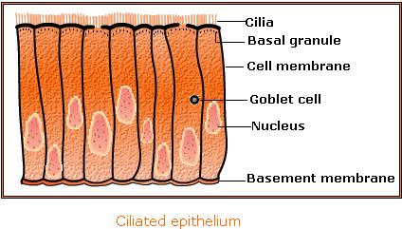

Slide 38
Flagellum
This is a long, motile, whip like projection from a cell
Example and functions:
The only human cell that possesses flagellum is sperm
It produces undulated movements that help in locomotion of whole cell

Slide 39
Stereocilia
These are nothing but extremely long microvilli resembling cilia.
Example and functions:
Chiefly found on cells lining epididymis
Also found on neuroepithelial and sustentacular cells of taste buds and hair cells of internal ear
In epididymis
In taste buds and internal ear: trigger electrical signals when they are stimulated by appropriate signals

Slide 40
Functions of epithelium
Protection
Secretion
Absorption
Excretion
Transport
Sensory perception
Reproduction

