Slide 1
The Cardiovascular System: The Heart
Anatomy
‹#›
Notes:
Chapter 18, Cardiovascular System
‹#›

Slide 2
Heart Anatomy
Approximately the size of your fist
Location
  Superior surface of diaphragm
  Left of the midline
  Anterior to the vertebral column, posterior to the sternum
‹#›

Slide 3
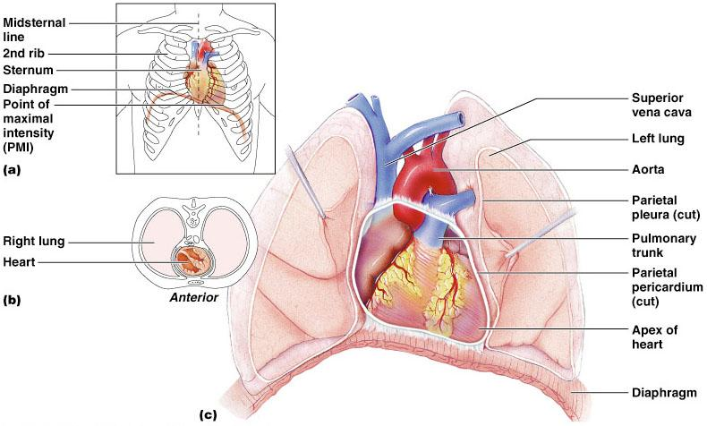
Heart Anatomy
‹#›

Slide 4
Coverings of the Heart: Anatomy
Pericardium – a double-walled sac around the heart composed of:
  A superficial fibrous pericardium
  A deep two-layer serous pericardium
    The parietal layer lines the internal surface of the fibrous pericardium
    The visceral layer or epicardium lines the surface of the heart
    They are separated by the fluid-filled pericardial cavity
‹#›

Slide 5
Coverings of the Heart: Physiology
The Function of the Pericardium:
  Protects the heart
  Prevents overfilling of the heart with blood
  Allows for the heart to work in a relatively friction-free environment
Chapter 18, Cardiovascular System
‹#›

Slide 6
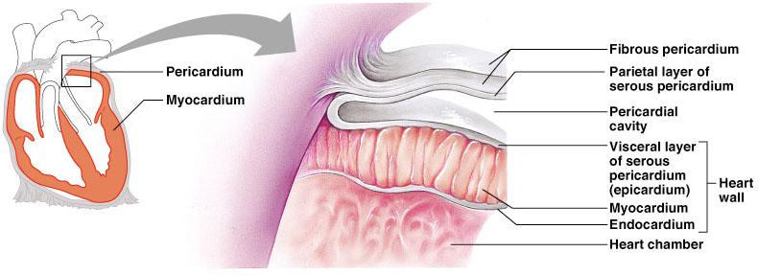
Pericardial Layers of the Heart
‹#›

Slide 7
Heart Wall
Epicardium – visceral layer of the serous pericardium
Myocardium – cardiac muscle layer forming the bulk of the heart
Fibrous skeleton of the heart – crisscrossing, interlacing layer of connective tissue
Endocardium – endothelial layer of the inner myocardial surface
‹#›

Slide 8
External Heart: Major Vessels of the Heart (Anterior View)
Vessels returning blood to the heart include:
  Superior and inferior venae cavae
  Right and left pulmonary artery
  Vessels conveying blood away from the heart include:
  Pulmonary trunk, which splits into right and left pulmonary arteries
  Ascending aorta (three branches) –
    Brachiocephalic
    Left common carotid
    Subclavian arteries
Chapter 18, Cardiovascular System
‹#›

Slide 9
External Heart: Vessels that Supply/Drain the Heart (Anterior View)
Arteries – right and left coronary (in atrioventricular groove), marginal, circumflex, and anterior interventricular arteries
Veins – small cardiac, anterior cardiac, and great cardiac veins
Chapter 18, Cardiovascular System
‹#›

Slide 10
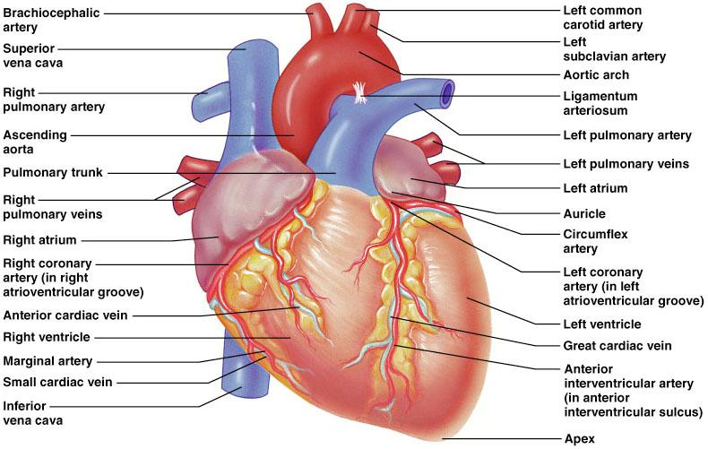
External Heart: Anterior View
Figure 18.4b
Chapter 18, Cardiovascular System
‹#›

Slide 11
External Heart: Major Vessels of the Heart (Posterior View)
Vessels returning blood to the heart include:
  Right and left pulmonary artery
  Superior and inferior venae cava
Vessels conveying blood away from the heart include:
  Aorta
  Right and left pulmonary vein
Chapter 18, Cardiovascular System
‹#›

Slide 12
External Heart: Vessels that Supply/Drain the Heart (Posterior View)
Arteries – right coronary artery (in atrioventricular groove) and the posterior interventricular artery (in interventricular groove)
Veins – great cardiac vein, posterior vein to left ventricle, coronary sinus, and middle cardiac vein
Chapter 18, Cardiovascular System
‹#›

Slide 13
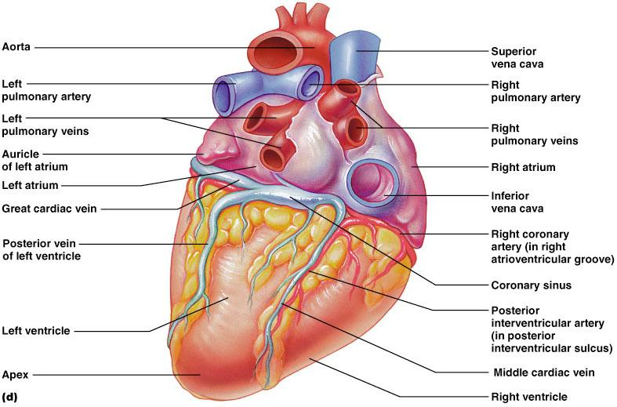
External Heart: Posterior View
Chapter 18, Cardiovascular System
‹#›
Figure 18.4d

Slide 14
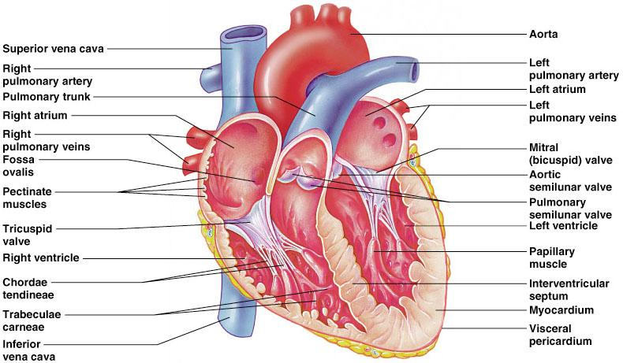
Gross Anatomy of Heart: Frontal Section
Figure 18.4e
Chapter 18, Cardiovascular System
‹#›

Slide 15
Atria of the Heart
Atria are the receiving chambers of the heart
Each atrium has a protruding auricle
Pectinate muscles mark atrial walls
Blood enters right atria from superior and inferior venae cavae and coronary sinus
Blood enters left atria from pulmonary veins
Chapter 18, Cardiovascular System
‹#›
Notes:
One auricle is attached to each of the anterior surfaces of the outer-walls of the atria (that is, the left atrium and the right atrium). Visually, they look like wrinkled pouch-like structures.
Chapter 18, Cardiovascular System
‹#›

Slide 16
Ventricles of the Heart
Ventricles are the discharging chambers of the heart
Papillary muscles and trabeculae carneae muscles mark ventricular walls
Right ventricle pumps blood into the pulmonary trunk
Left ventricle pumps blood into the aorta
Chapter 18, Cardiovascular System
‹#›
Notes:
Chapter 18, Cardiovascular System
‹#›

Slide 17
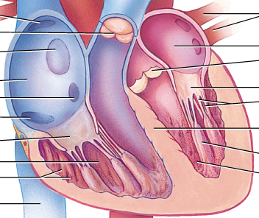
Myocardial Thickness and Function
Thickness of myocardium varies according to the function of the chamber
Atria are thin walled, deliver blood to adjacent ventricles
Ventricle walls are much thicker and stronger
  right ventricle supplies blood to the lungs (little flow resistance)
  left ventricle wall is the thickest to supply systemic circulation
Chapter 18, Cardiovascular System
‹#›

Slide 18
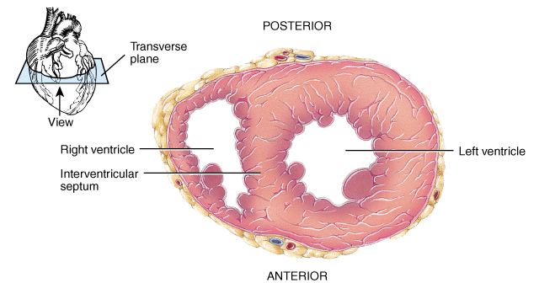
Thickness of Cardiac Walls
Myocardium of left ventricle is much thicker than the right.
Chapter 18, Cardiovascular System
‹#›

Slide 19
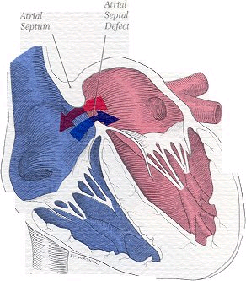
Atrial Septal Defect
Chapter 18, Cardiovascular System
‹#›

Slide 20
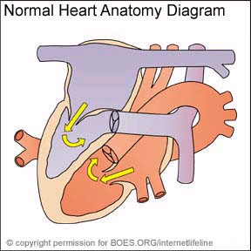
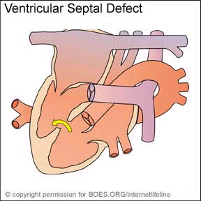
Ventricular Septal Defect
Chapter 18, Cardiovascular System
‹#›

Slide 21
Pathway of Blood Through the Heart and Lungs
Right atrium 🡪 tricuspid valve 🡪 right ventricle
Right ventricle 🡪 pulmonary semilunar valve 🡪 pulmonary arteries 🡪 lungs
Lungs 🡪 pulmonary veins 🡪 left atrium
Left atrium 🡪 bicuspid valve 🡪 left ventricle
Left ventricle 🡪 aortic semilunar valve 🡪 aorta
Aorta 🡪 systemic circulation
Chapter 18, Cardiovascular System
‹#›

Slide 22
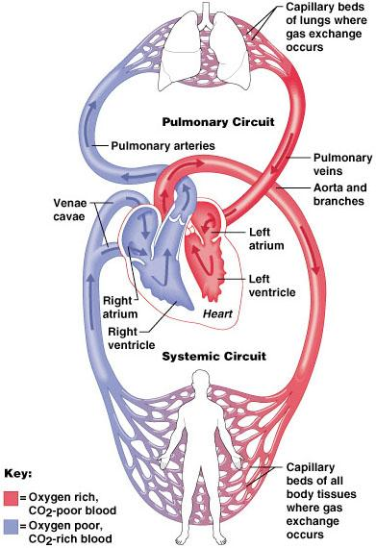
Pathway of Blood Through the Heart and Lungs
Figure 18.5
Chapter 18, Cardiovascular System
‹#›

Slide 23
Coronary Circulation
Coronary circulation is the functional blood supply to the heart muscle itself
Collateral routes ensure blood delivery to heart even if major vessels are occluded
Chapter 18, Cardiovascular System
‹#›

Slide 24
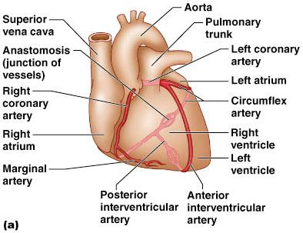
Coronary Circulation: Arterial Supply
Chapter 18, Cardiovascular System
‹#›
Figure 18.7a

Slide 25
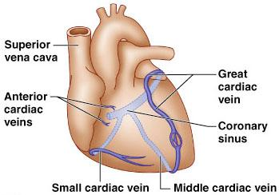
Coronary Circulation: Venous Supply
Chapter 18, Cardiovascular System
‹#›
Figure 18.7b

Slide 26
Heart Valves
Heart valves ensure unidirectional blood flow through the heart
Atrioventricular (AV) valves lie between the atria and the ventricles
  AV valves prevent backflow into the atria when ventricles contract
Chordae tendineae anchor AV valves to papillary muscles
Chapter 18, Cardiovascular System
‹#›
Notes:
The chordae tendineae are a group of tough, tendinous strands in the heart. They are commonly referred to as the “heart strings” since they resemble small pieces of string. Functionally, the chordae tendineae play a vital role in holding the atrioventricular valves in place while the heart is pumping blood.
Chapter 18, Cardiovascular System
‹#›

Slide 27
Heart Valves
Semilunar valves prevent backflow of blood into the ventricles
Aortic semilunar valve lies between the left ventricle and the aorta
Pulmonary semilunar valve lies between the right ventricle and pulmonary trunk
Chapter 18, Cardiovascular System
‹#›

Slide 28
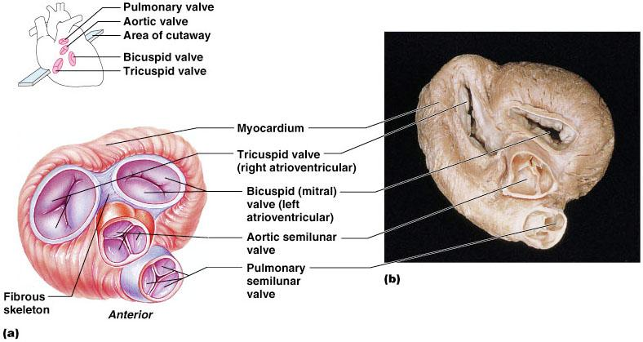
Heart Valves
Figure 18.8a, b
Chapter 18, Cardiovascular System
‹#›

Slide 29
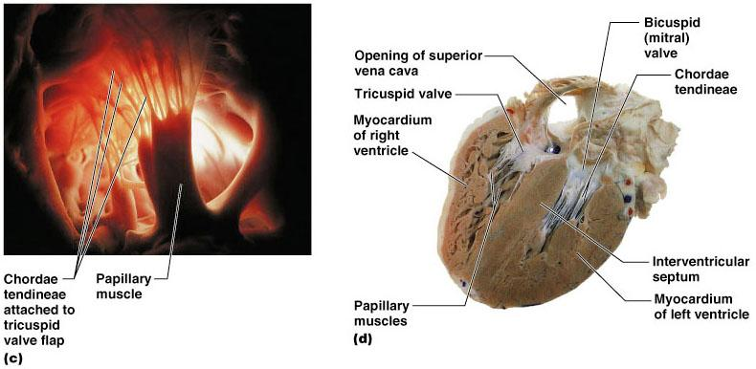
Heart Valves
Figure 18.8c, d
Chapter 18, Cardiovascular System
‹#›

Slide 30
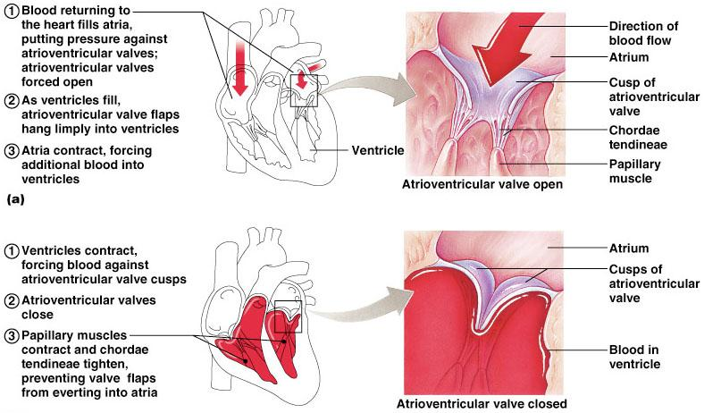
Atrioventricular Valve Function
Figure 18.9
Chapter 18, Cardiovascular System
‹#›

Slide 31
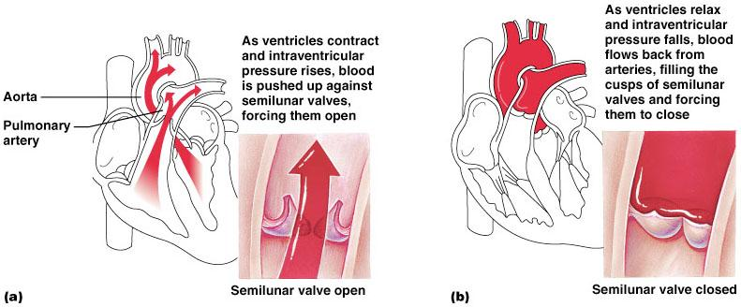
Semilunar Valve Function
Figure 18.10
Chapter 18, Cardiovascular System
‹#›

Slide 32
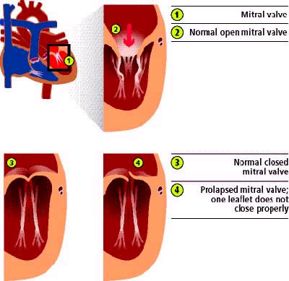
Mitral Valve Prolapse
Chapter 18, Cardiovascular System
‹#›

Slide 33
Microscopic Anatomy of Heart Muscle
Cardiac muscle is striated, short, fat, branched, and interconnected
The connective tissue endomysium acts as both tendon and insertion
Intercalated discs anchor cardiac cells together and allow free passage of ions
Heart muscle behaves as a functional syncytium
Chapter 18, Cardiovascular System
‹#›
Notes:
Intercalated discs are microscopic identifying features of cardiac muscle. Cardiac muscle consists of individual heart muscle cells (cardiomyocytes) connected by intercalated discs to work as a single functional organ or syncytium. ... Intercalated discs support synchronized contraction of cardiac tissue.
Chapter 18, Cardiovascular System
‹#›

Slide 34
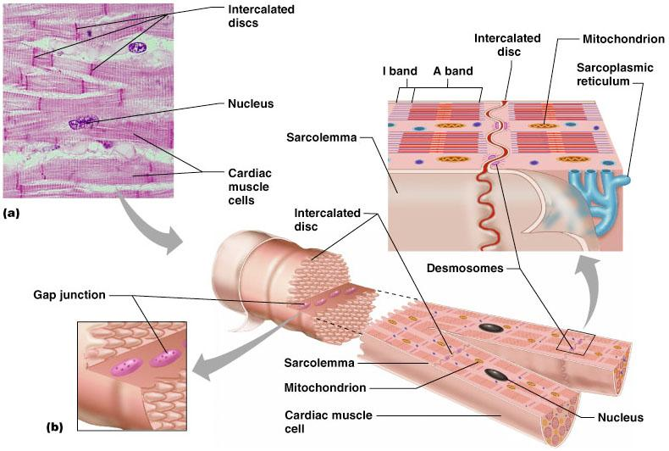
Microscopic Anatomy of Heart Muscle
Chapter 18, Cardiovascular System
‹#›
Figure 18.11

