Slide 1
Connective tissue

Slide 2
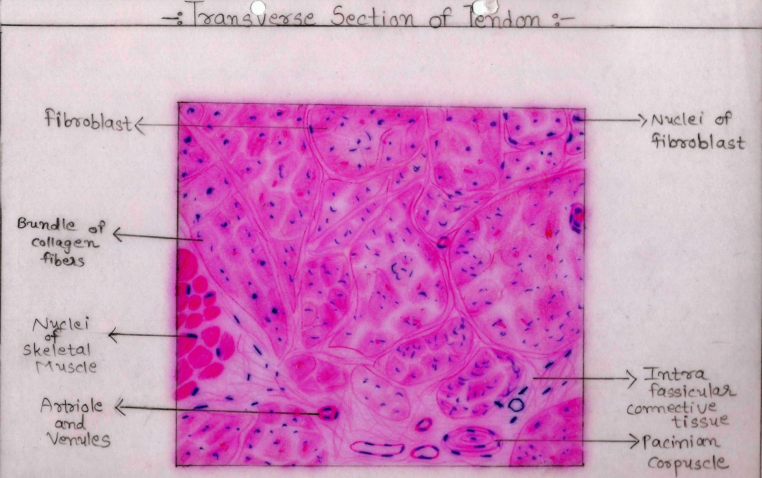
Connective tissue

Slide 3
Connective tissue:
Basic tissue that provides structural and metabolic support to other body structures
Derived from mesoderm
Contain:
1. few cells
2. large extracellular matrix

Slide 4
Functions:
1.Structural support:
Act as packing material
Provide tough physical support
Make skeletal framework( bone and cartilage)
2.Metabolic support:
Contain blood vessels(exchange of nutrients)
Fat storage
Temperature regulation

Slide 5
Functions:
3: tissue repair and wound healing
4. Defence:
physical barrier
Include tissue cells i.e macrophage, phagocytic organisms
Plasma cells form antibodies (neutralize pathogens)
Note: A macrophage is a type of phagocyte, which is a cell responsible for detecting, engulfing and destroying pathogens and apoptotic cells

Slide 6
Connective tissue components
Extracellular matrix
Ground substance:
1.GAGs
2.Proteoglycans
3.glycoproteins
Fibers:
1.Collagen
2.Reticular
3.elastic
Cells
1.Fibroblast
2.Histiocytes
3.Mast cells
4.Adipocytes
5.Plasma cells
6.Other WBCs
Notes:
connective tissue elements are embedded in Ground substance= "filler" substance existing between cells in connective tissues
Glycosaminoglycans (GAGs)
contain type III collagen (Reticular) eg bone marrow, liver cells
critical role in wound healing= fibroblast
Histiocytes = immune cell
3.Mast cells eg histamine
4.Adipocytes =storage of fat

Slide 7
Supporting tissue cells:
Fibroblasts:
large cells that produce supporting tissue fibers and ground substance
Histiocytes(macrophages):
important part of body’s defence .engulf foreign particles. They ingest, process and present antigens to lymphocytes and plasma cells
Mast cells:
large , round and ovoid cells that secrete heparin(anticoagulant) and histamine(vasodilator)

Slide 8
Adipocytes:
Large ovoid or spherical cells consisting of single large fat vacuole or multiple small fat vacuoles .
White adipose: stores fat
Brown adipose : maintain temperature in newborn
Plasma cells:
Large ovoid cells that produce antibodies
Wandering cells:
WBC including neutrophil, eosinophil, lymphocyte and basophil
Notes:
eosinophil=inflammatory processes
Basophil= heparin and histamine
Neutrophil= kill invading agents

Slide 9
Fibers:
Collagen Fibers:
Large fibers made of the protein collagen and are typically the most abundant fibers.
Promote tissue flexibility.
Elastic Fibers:
Intermediate fibers made of the protein elastin.
Branching fibers that allow for stretch and recoil
Reticular Fibers:
Small delicate, branched fibers that have same chemical composition of collagen
Forms structural framework for organs such as spleen and lymph nodes

Slide 10
Ground substance:
Transparent material like a semi fluid gel in which supporting tissue and fibers are embedded.
GAGs: long , unbranched polysaccharide chains of seven different types , each composed of repeating diasaccharide units.
Hyaloronic acid: predominant. Charge make them hydrophilic thus attract water and ions

Slide 11
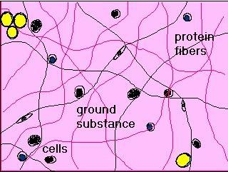

Slide 12
Proteoglycans: GAGs binding to proteins
Glycoproteins: protein chains bound to branched polysaccharide

Slide 13
Basement membrane:
It’s a condensed layer of extracellular matrix that forms boundary between connective tissue and epithelial, muscle and nervous tissue
In muscle and nervous tissue: called external lamina.
Composed of: GAGs , collagen type IV and glycoproteins

Slide 14
Types of connective tissue:
True Connective Tissue
a. Loose Connective Tissue
b. Dense Connective Tissue
2. Supportive Connective Tissue
a. Cartilage
b. Bone
5. Liquid Connective Tissue
a. Blood

Slide 15
True or Proper Connective Tissue
1.loose connective tissue:
a. Areolar tissue
Widely distributed under epithelia
b. Adipose tissue
Hypodermis, within abdomen, breasts
c. Reticular connective tissue
Lymphoid organs such as lymph nodes

Slide 16
LOOSE Connective Tissue:
1. Areolar CT
  consists of all 3 types of fibers, several types of cells, and semi-fluid ground substance
  found in subcutaneous layer and mucous membranes, and around blood vessels, nerves and organs
  function = strength, support and elasticity

Slide 17
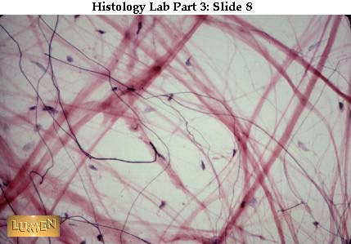

Slide 18
2. Adipose tissue
  consists of adipocytes; "signet ring" appearing fat cells. They store energy in the form of triglycerides (lipids).
  found in subcutaneous layer, around organs and in the yellow marrow of long bones
  function = supports, protects and insulates, and serves as an energy reserve

Slide 19
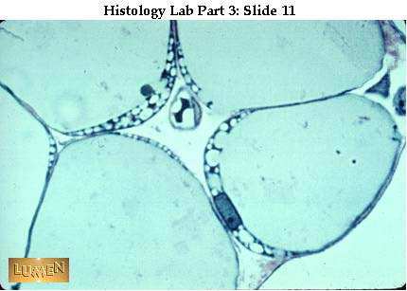

Slide 20
3. Reticular CT
  Consists of fine interlacing reticular fibers and reticular cells
  Found in liver, spleen and lymph nodes
  Function = forms the framework (stroma) of organs and binds together smooth muscle tissue cells

Slide 21
True or Proper Connective Tissue
2.dense connective tissue:
a. Dense regular connective tissue
Tendons and ligaments
b. Dense irregular connective tissue
Dermis of skin, submucosa of digestive tract

Slide 22
Dense Connective Tissue:
contains more numerous and thicker fibers and far fewer cells than loose CT
1. dense regular Connective Tissue
  consists of bundles of collagen fibers and fibroblasts
  forms tendons, ligaments and aponeuroses
  Function = provide strong attachment between various structures

Slide 23
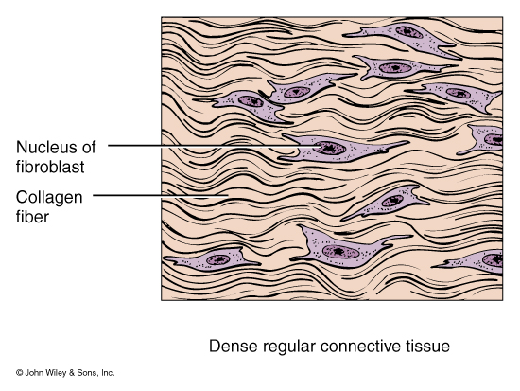

Slide 24
2. Dense Irregular CT
  consists of randomly-arranged collagen fibers and a few fibroblasts
  Found in fasciae, dermis of skin, joint capsules, and heart valves
  Function = provide strength

Slide 25
